Slide 1
ARM Templates
Dorian Vallecillo Calderon
App Service Senior Support Engineer Dev-OSS/Perf-Config

Slide 2
Vender tu idea
Have you ever wonder how deployments of services and infrastructure is made within Azure Cloud?

Slide 3


ARM
Elige un enfoque para captar la atención de la audiencia desde el principio: puede ser inesperado, afectivo o sencillo.
Azure Resource Manager Destaca lo nuevo, inusual o sorprendente del producto, servicio o idea.
Deployment of Infrastructure Menciona las razones por las que a la gente les puede interesar el producto.
Developing ARM’s Templates Di de una manera sencilla y resumida de qué vas a hablar a continuación.

Slide 4
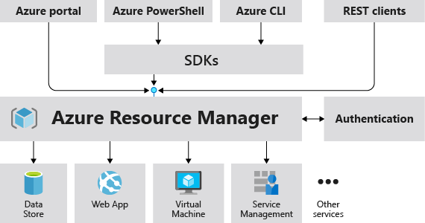
¿How does Azure Resource Manager works?
Notes:
https://docs.microsoft.com/en-us/azure/azure-resource-manager/management/overview

Slide 5
What benefits do I get of using ARM Templates?
Manage your infrastructure through declarative templates rather than scripts.
Deploy, manage, and monitor all the resources for your solution as a group, rather than handling these resources individually.
Redeploy your solution throughout the development lifecycle and have confidence your resources are deployed in a consistent state.
Define the dependencies between resources so they're deployed in the correct order.
Apply access control to all services because Azure role-based access control (Azure RBAC) is natively integrated into the management platform.
Apply tags to resources to logically organize all the resources in your subscription.
Clarify your organization's billing by viewing costs for a group of resources sharing the same tag.

Slide 6
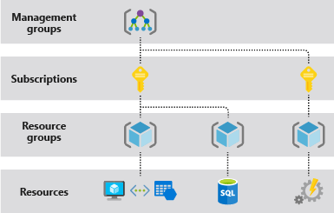
Scope of the ARM

Slide 7
What are the components of an ARM Template
Al final de este apartado, la audiencia debe ser capaz de responder a estas dos preguntas:
$schema = API used to define resources
contentVersion = Versioning control variable
parameters = Input Parameters
functions = customized functions
variables = re-usage of parameters or values
resources = Resource Provider
outputs= customized outputs ución.

Slide 8
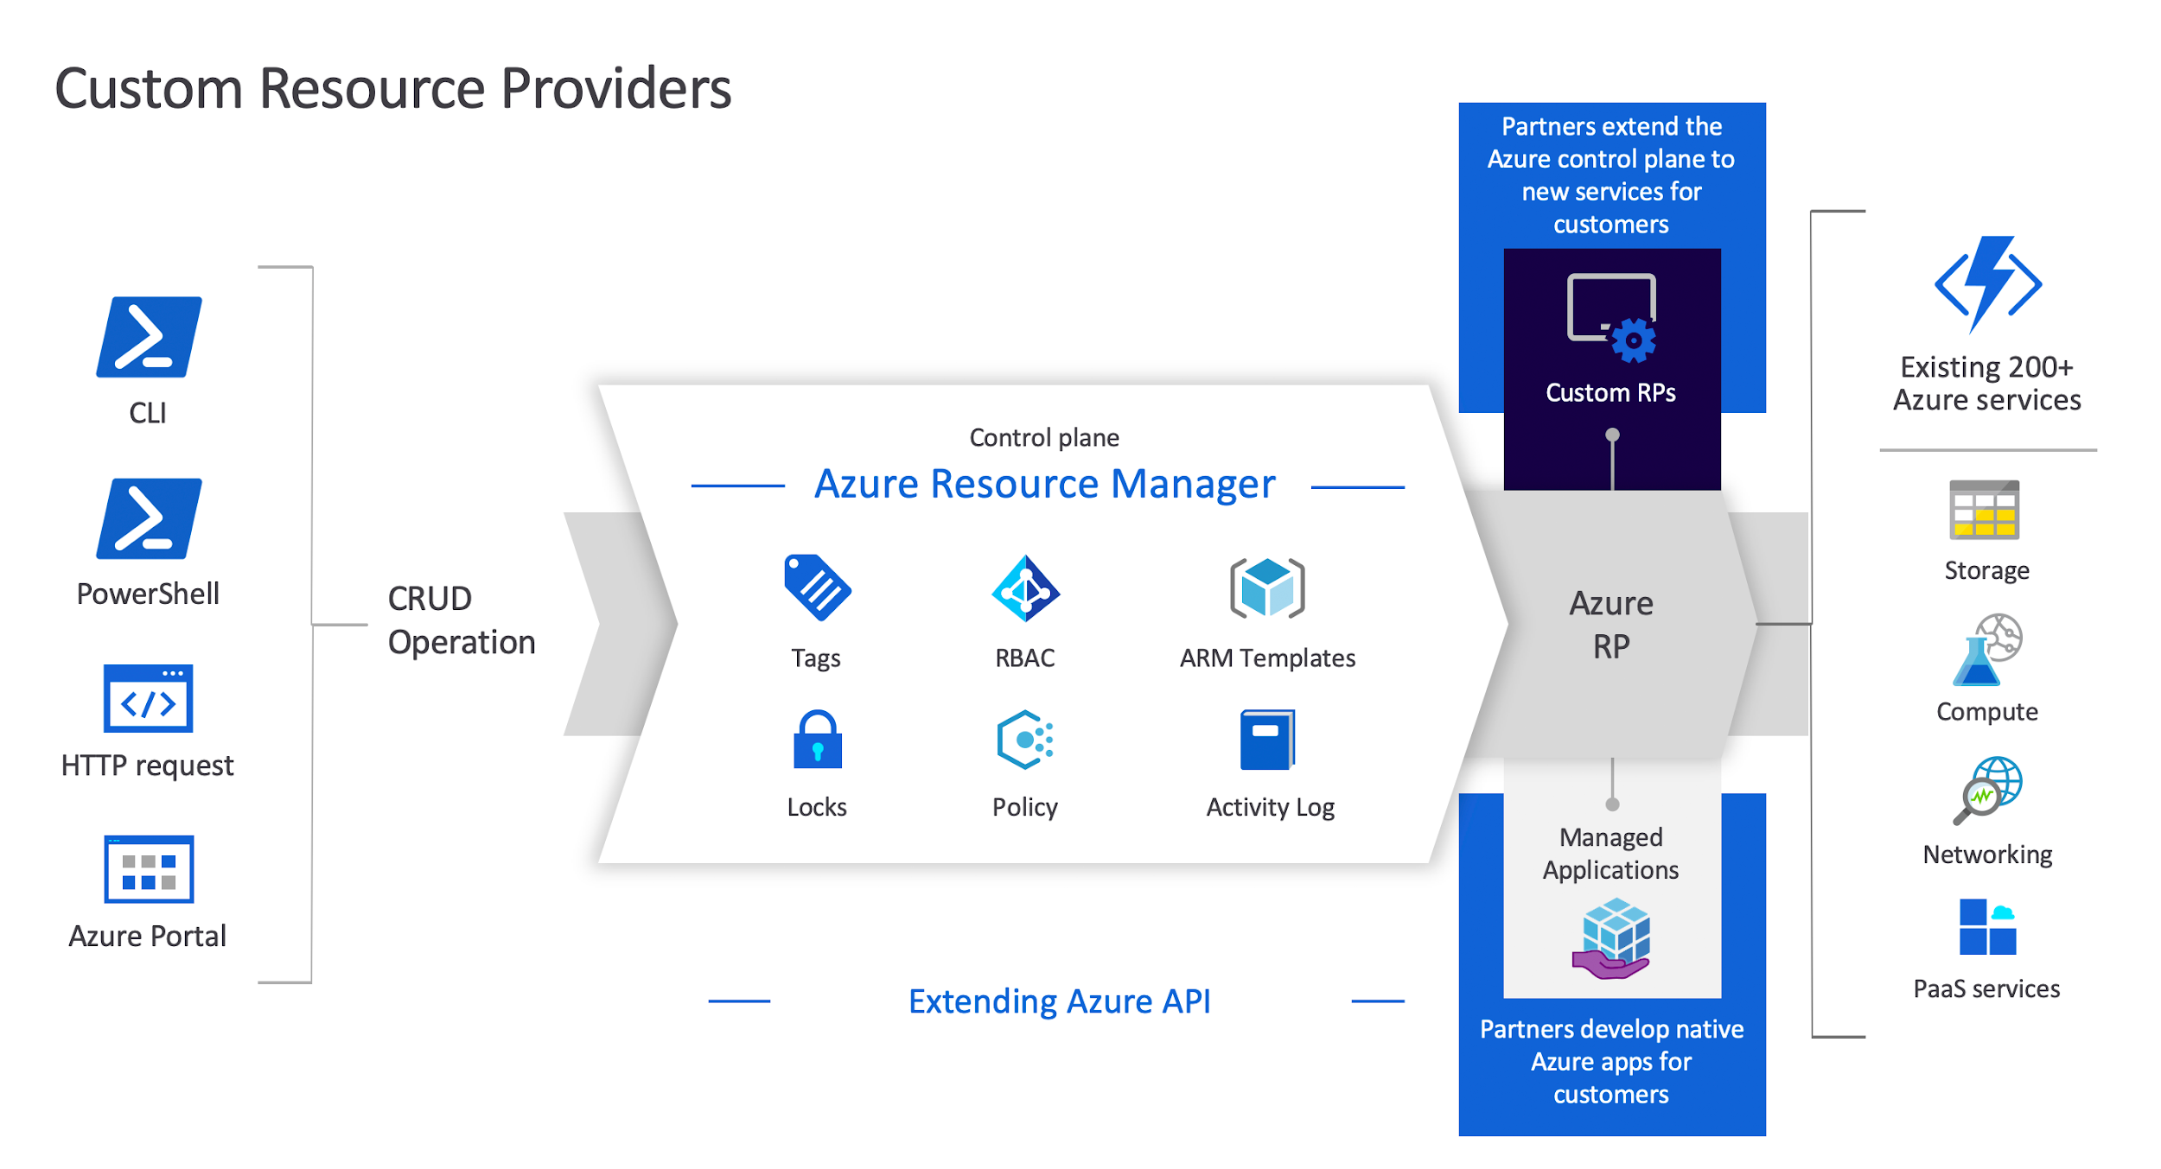
What is a resource provider?
Clean ARM Template
{
"$schema": "https://schema.management.azure.com/schemas/2019-04-01/deploymentTemplate.json#",
"contentVersion": "1.0.0.0",
"parameters": {},
"functions": [],
"variables": {},
"resources": [],
"outputs": {}
}
Le encanta el fútbol, pero no podía comunicarse con el entrenador ni con los jugadores de un equipo.
Notes:
https://docs.microsoft.com/en-us/azure/templates/
https://docs.microsoft.com/en-us/azure/azure-resource-manager/management/azure-services-resource-providers

Slide 9
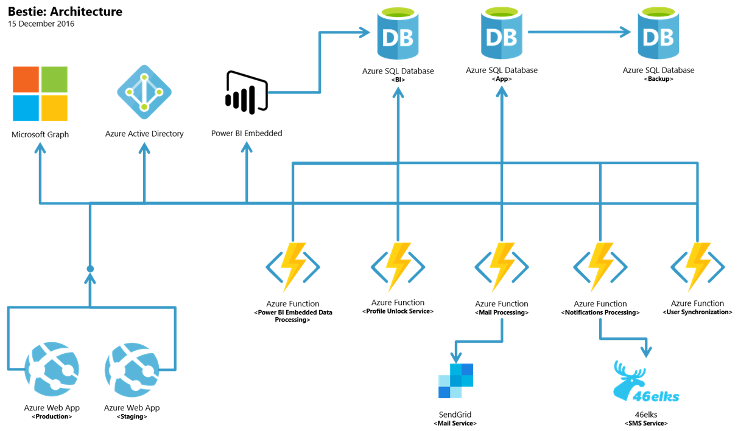
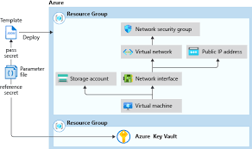
IaC
Hace poco abrió una tienda de cámaras de fotos cerca del Museo del Louvre en París.
Las personas que visitan su tienda (turistas en su mayoría) hablan varios idiomas, por lo que atenderlas supone todo un reto para él.

Slide 10
Let’s go to VS Code and let’s get started with Coding Infrastructure.
Repository:
https://github.com/dorianivc/ARM-templates-training-for-WebApps

Slide 11
VS Code
ARM Introductions:
App Service Plan
App Service
ARM Paramatrization
App Service Plan
App Service
Allowed & Default Values
ARM Variables & Output
ARM variables
ARM outputs
ARM parameters file
Let’s create it on VSCode

Slide 12
Robots don’t make mistakes -- but data DOES!
Have a nice day

